Slide 2

3rd Tech Demo
RPG Combat System (Mobile)

Slide 3



Slide 4




RPG Combat system
Movement & Animation
Target System
Normal Attack System
Damage System
Death System
Aggro System
Buff System
HUD Design
Abilities
Enemy

Slide 5
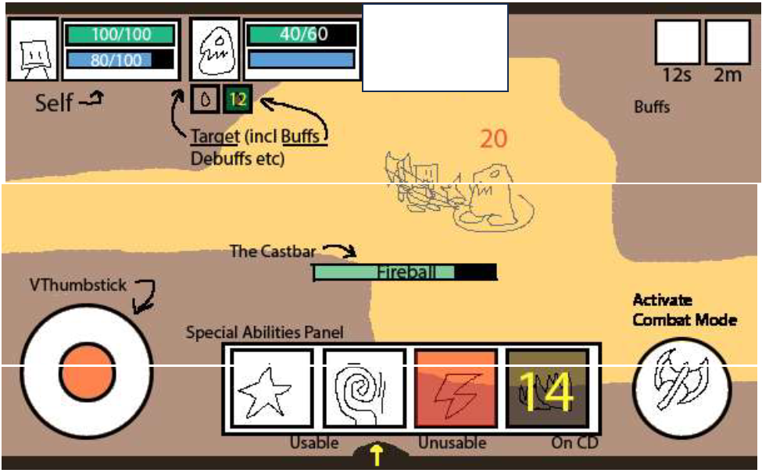
RPG Combat system HUD Reference

